Slide 1
MY ZOO OOP
20132329 Chan-gyu Kim
20132377 Sung-min Shin
20132385 Seon Oh

Slide 2
Contents
Total program Structure
Class description
Animal
Cage
Controler
Manager
Monitor
Scene
Sound
Viewer
Sample screenshots

Slide 3
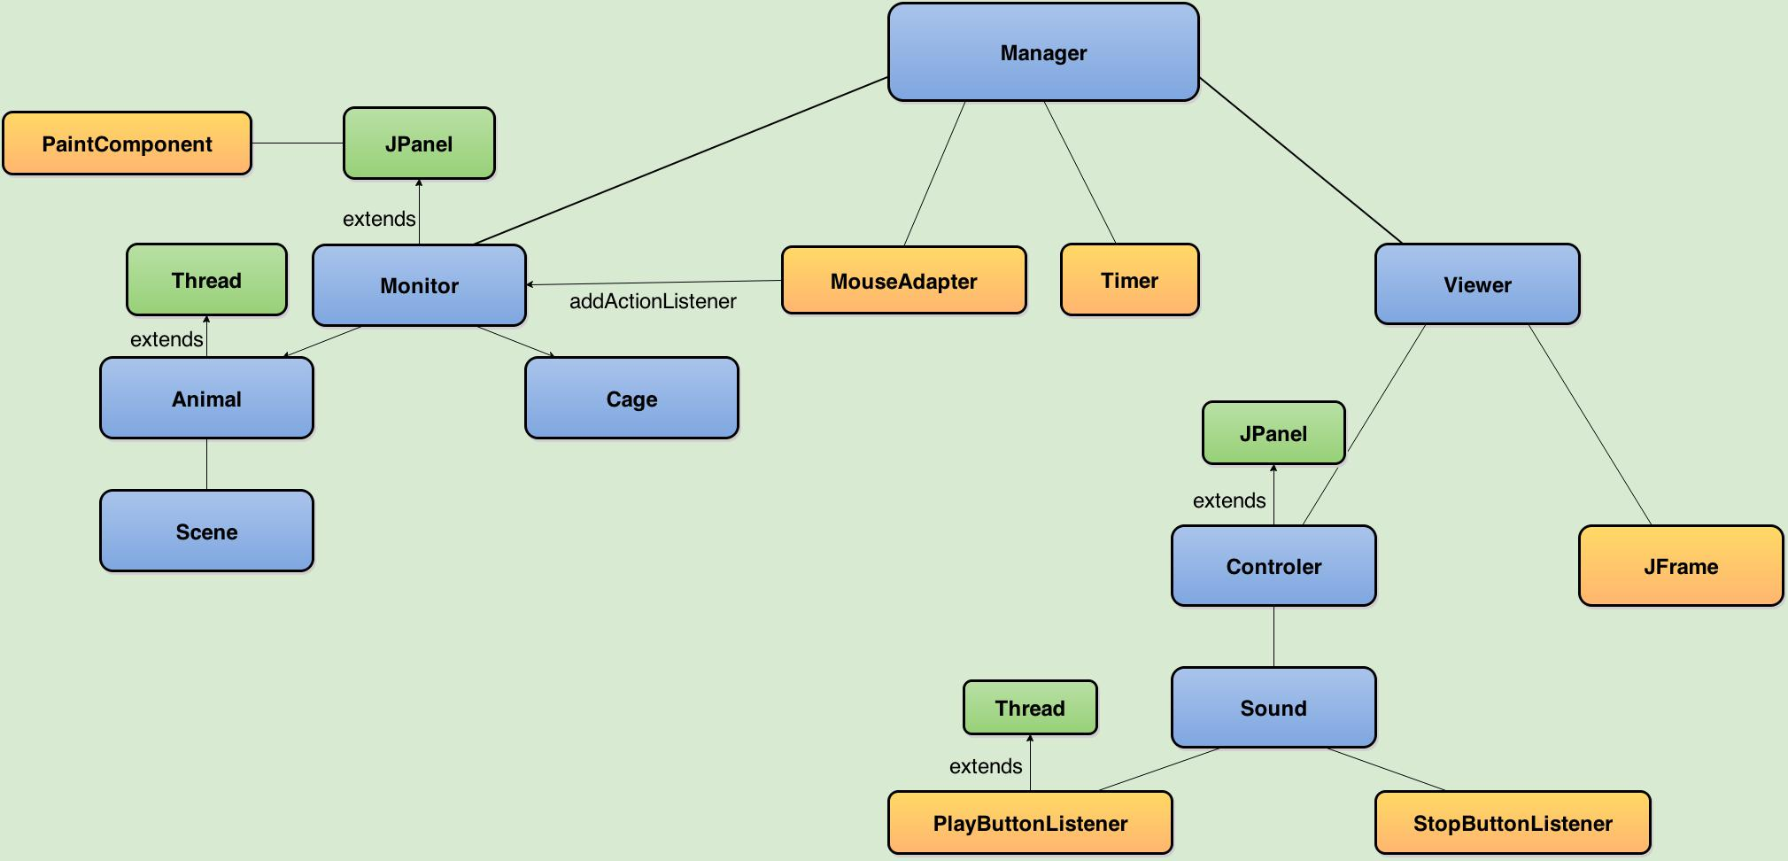
Total program Structure

Slide 4
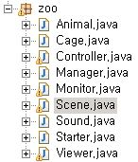
Class description
Animal
Cage
Controller
Manager
Monitor
Scene
Sound
Viewer

Slide 5
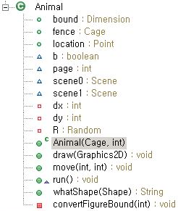
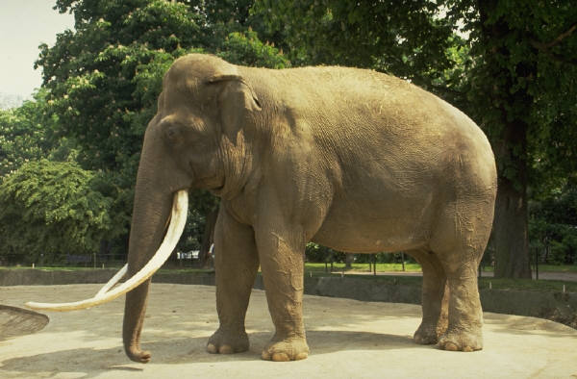
Animal
Get Point the File I/O
Draw Animal
Using Graphics2D
Moving Animal
Using Thread
Bounding when crash the Cage

Slide 6
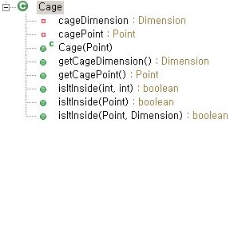

Cage
Made cage
That has just Point
Checking is Manager

Slide 7
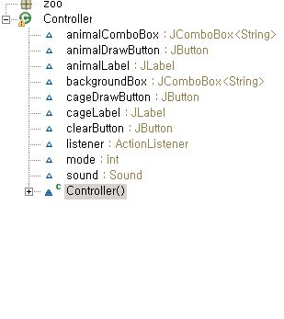

Controller
Make control system on animal and other
Use ActionListener
We can choice Background image and clear whole thing

Slide 8
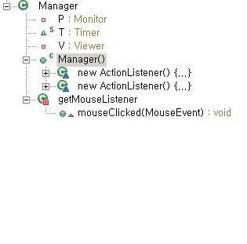

Manager
Make a viewer
That is Frame for this program
Listen MouseEvent

Slide 9
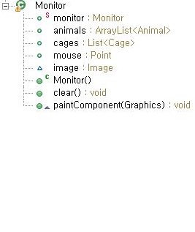
Monitor
Drawing Animal and Cage
paintComponent
Setting Stroke and Color is working Scene

Slide 10
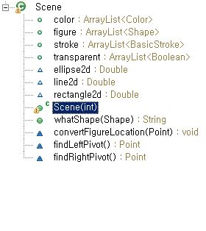
Scene
Setting Stroke and Color when draw Animal
Data from the File I/O
Find pivot the animal
That used for Bounding

Slide 11
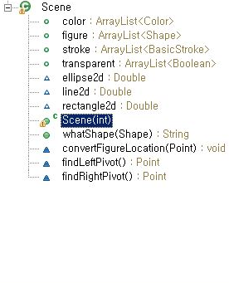

Sound
Play musicfile
File format is MPEG-3
Using external library
Open souce
Jlayout that is refers Java Media Framework (JMF) etc

Slide 12
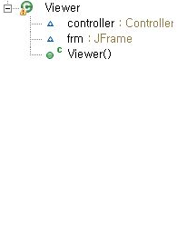

Viewer
Frame

Slide 13
Thanks to Listen!
Q&A

